Slide 1

A Study on
Frequent pattern mining
Thanjida Akhter
takhter@mun.ca

Slide 2
Contents
Abstract
Introduction
Motivation, Applications, Importance
Algorithm names
Basic Concepts
Algorithm Details
Time Complexity
Reference

Slide 3
Abstract
Pattern mining algorithms can be applied on various types of data such as sub graphs, associations, indirect associations, trends, periodic patterns, sequential rules, lattices, sequential patterns, high-utility patterns, etc. Example like frequent pattern mining is that of finding relationships among the items or pattern in a database those products that are frequently purchased together by customers. This paper introduces a detailed analysis of the algorithms focusing on frequent pattern mining also try to find suitable algorithm base on time complexity

Slide 4


What is data mining?
the use of sophisticated data analysis tools to discover previously unknown, valid patterns and relationships in large data sets
Data
Information

Slide 5
Frequent Pattern?
Frequent Pattern: a pattern (a set of items, subsequences, substructures, etc.) that occurs frequently in a data set.
Databases: item(transaction), tree, graph, string, vectors,…
Patterns: itemset, tree, paths, cycles, graphs, geographs,…

Slide 6
Motivation
Motivation: Finding inherent regularities in data
What products were often purchased together?
What are the subsequent purchases after buying a PC?
What kinds of DNA are sensitive to this new drug?

Slide 7
Applications
Supermarket
Product placement
special promotions
Web search
which keywords often occur together in webpages?
Heath care
frequent sets of symptoms for a disease
DNA sequence

Slide 8
Importance
Discloses an intrinsic and important property of data sets
Forms the foundation for many essential data mining tasks
Association, correlation, and causality analysis
Sequential, structural pattern
Pattern analysis in spatiotemporal, multimedia, time-series.
Classification: associative classification
Cluster analysis: frequent pattern-based clustering
Notes:
Virtual Infrastructure: virtual machines, virtual storage disks, virtual networks or virtual data centers.

Slide 9
Some Algorithm names
Apriori
FP Growth
Eclat
SaM
PrefixSpan
Broglet’s FP-Growth
Goethals FP-Growth
Vertical data format approach

Slide 10
Three major approaches
A brief description of the three frequent pattern mining algorithms namely Apriori, Eclat and FP Growth
Apriori [Agrawal & Srikant 1994]
FP-growth [Han, Pei & Yin 2000]
Eclat[MJ Zaki, S Parthasarathy, M Ogihara, W Li - KDD, 1997]

Slide 11
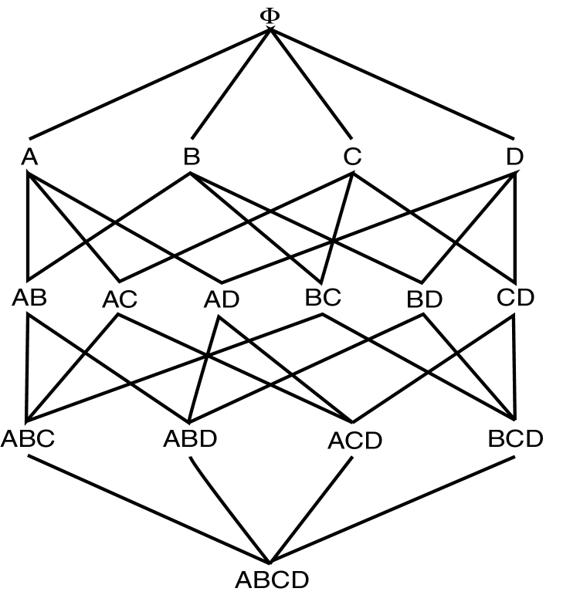
Apriori Algorithm
Apriori principle:
Self-joining (L*L)
Pruning(If there is any itemset which is infrequent, its superset should not be generated/tested)
Large Itemset Property

Slide 12
Apriori: Example
Sup_{min} = 2
Itemset | sup
{A} | 2
{B} | 3
{C} | 3
{D} | 1
{E} | 3
Database
Itemset | sup
{A} | 2
{B} | 3
{C} | 3
{E} | 3
L₁
Tid | Items
10 | A, C, D
20 | B, C, E
30 | A, B, C, E
40 | B, E
C₁
1st scan
C₂
C₂
Itemset | sup
{A, B} | 1
{A, C} | 2
{A, E} | 1
{B, C} | 2
{B, E} | 3
{C, E} | 2
L₂
2nd scan
Itemset
{A, B}
{A, C}
{A, E}
{B, C}
{B, E}
{C, E}
Itemset | sup
{A, C} | 2
{B, C} | 2
{B, E} | 3
{C, E} | 2
C₃
Itemset
{B, C, E}
3rd scan
L₃
Itemset | sup
{B, C, E} | 2

Slide 13
Advantages & Disadvantages
Advantages:
Uses large itemset property
Easily parallelized
Easy to implement
Disadvantages:
Assumes transaction database is memory resident
Requires database scans

Slide 14
FP-growth
Use a compressed representation of the database using an FP-tree
Once an FP-tree has been constructed, it uses a recursive divide-and-conquer approach to mine the frequent itemsets

Slide 15
FP-tree construction
null
After reading TID=1:
A:1
B:1
After reading TID=2:
null
A:1
B:1
B:1
C:1
D:1

Slide 16
FP-Tree Construction
Transaction Database
null
A:7
B:3
B:5
C:3
C:1
D:1
Header table
D:1
C:3
E:1
D:1
E:1
D:1
E:1
D:1

Slide 17
FP-growth
Build conditional pattern base for E: P = {(A:1,C:1,D:1), (A:1,D:1), (B:1,C:1)}
Recursively apply FP-growth on P
null
A:7
B:3
B:5
C:3
C:1
D:1
C:3
D:1
D:1
E:1
D:1
E:1
E:1
D:1

Slide 18
FP-growth
Conditional tree for E:
Conditional Pattern base for E: P = {(A:1,C:1,D:1,E:1), (A:1,D:1,E:1), (B:1,C:1,E:1)}
Count for E is 3: {E} is frequent itemset
Recursively apply FP-growth on P
null
A:2
B:1
C:1
C:1
D:1
D:1
E:1
E:1
E:1

Slide 19
FP-growth
Conditional tree for D within conditional tree for E:
Conditional pattern base for D within conditional base for E: P = {(A:1,C:1,D:1), (A:1,D:1)}
Count for D is 2: {D,E} is frequent itemset
Recursively apply FP-growth on P
null
A:2
C:1
D:1
D:1

Slide 20
FP-growth
Conditional tree for C within D within E:
Conditional pattern base for C within D within E: P = {(A:1,C:1)}
Count for C is 1: {C,D,E} is NOT frequent itemset
null
A:1
C:1

Slide 21
FP-growth
Conditional tree for A within D within E:
Count for A is 2: {A,D,E} is frequent itemset
Next step:
Construct conditional tree C within conditional tree E
Continue until exploring conditional tree for A (which has only node A)
null
A:2

Slide 22
FP-growth
null
Conditional Pattern base for D: P = {(A:1,B:1,C:1), (A:1,B:1), (A:1,C:1), (A:1), (B:1,C:1)}
Recursively apply FP-growth on P
A:7
B:1
B:5
C:1
C:1
D:1
C:3
D:1
D:1
D:1
D:1

Slide 23
FP-growth
Frequent Itemsets found (with min sup = 2): AD, BD, CD, ACD, BCD, ABD

Slide 24
Challenges of Frequent Pattern Mining
Multiple scans of transaction database
Huge number of candidates
Tedious workload of support counting for candidates

Slide 25
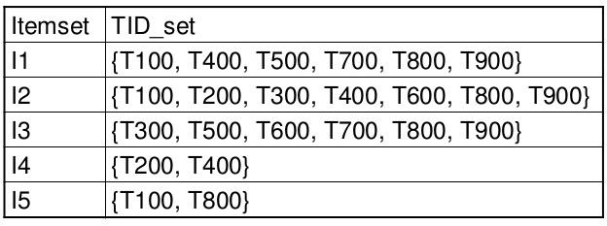
Vertical Layout
Rather than have
Transaction ID – list of items (Transactional)
We have
Item – List of transactions (TID-list)
Now to count itemset AB
Intersect TID-list of item A with TID-list of item B
All data for a particular item is available

Slide 26
Eclat Algorithm
Dynamically process each transaction online maintaining 2-itemset counts.
Transform
Partition L2 using 1-item prefix
Equivalence classes - {AB, AC, AD}, {BC, BD}, {CD}
Transform database to vertical form
Asynchronous Phase
For each equivalence class E
Compute frequent (E)

Slide 27
Frequent Itemset Generation
ECLAT: for each item, store a list of transaction ids (tids); vertical data layout
TID-list

Slide 28
Frequent Itemset Generation
Determine support of any k-itemset by intersecting tid-lists of two of its (k-1) subsets.
3 traversal approaches:
top-down, bottom-up and hybrid
Advantage: very fast support counting
Disadvantage: intermediate tid-lists may become too large for memory
∧
→

Slide 29
ECLAT: FP Mining with Vertical Data Format
Both Apriori and FP-growth use horizontal data format
Alternatively data can also be represented in vertical format
TID | List of item IDS
T100 | I1,I2,I5
T200 | I2,I4
T300 | I2,I3
T400 | I1,I2,I4
T500 | I1,I3
T600 | I2,I3
T700 | I1,I3
T800 | I1,I2,I3,I5
T900 | I1,I2,I3
itemset | TID_set
I1 | {T100,T400,T500,T700,T800,T900}
I2 | {T100,T200,T300,T400,T600,T800,T900}
I3 | {T300,T500,T600,T700,T800,T900}
I4 | {T200,T400}
I5 | {T100,T800}

Slide 30
ECLAT Algorithm by Example
Transform the horizontally formatted data to the vertical format by scanning the database once
The support count of an itemset is simply the length of the TID_set of the itemset
TID | List of item IDS
T100 | I1,I2,I5
T200 | I2,I4
T300 | I2,I3
T400 | I1,I2,I4
T500 | I1,I3
T600 | I2,I3
T700 | I1,I3
T800 | I1,I2,I3,I5
T900 | I1,I2,I3
itemset | TID_set
I1 | {T100,T400,T500,T700,T800,T900}
I2 | {T100,T200,T300,T400,T600,T800,T900}
I3 | {T300,T500,T600,T700,T800,T900}
I4 | {T200,T400}
I5 | {T100,T800}

Slide 31
ECLAT Algorithm by Example
min_sup=2
Frequent 2-itemsets in vertical format
Frequent 1-itemsets in vertical format
itemset | TID_set
I1 | {T100,T400,T500,T700,T800,T900}
I2 | {T100,T200,T300,T400,T600,T800,T900}
I3 | {T300,T500,T600,T700,T800,T900}
I4 | {T200,T400}
I5 | {T100,T800}
itemset | TID_set
{I1,I2} | {T100,T400,T800,T900}
{I1,I3} | {T500,T700,T800,T900}
{I1,I4} | {T400}
{I1,I5} | {T100,T800}
{I2,I3} | {T300,T600,T800,T900}
{I2,I4} | {T200,T400}
{I2,I5} | {T100,T800}
{I3,I5} | {T800}
The frequent k-itemsets can be used to construct the candidate (k+1)-itemsets based on the Apriori property

Slide 32
ECLAT Algorithm by Example
Frequent 3-itemsets in vertical format
itemset | TID_set
{I1,I2,I3} | {T800,T900}
{I1,I2,I5} | {T100,T800}
min_sup=2
This process repeats, with k incremented by 1 each time, until no frequent items or no candidate itemsets can be found
Properties of mining with vertical data format
Take the advantage of the Apriori property in the generation of candidate (k+1)-itemset from k-itemsets
No need to scan the database to find the support of (k+1) itemsets, for k>=1
The TID_set of each k-itemset carries the complete information required for counting such support
The TID-sets can be quite long, hence expensive to manipulate

Slide 33
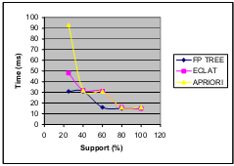
Comparison of Algorithms
Figure 1: Comparison of Apriori, Eclat and FP Growth algorithm on artificial dataset.

Slide 34
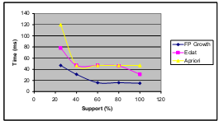
Comparison of Algorithms
Figure 2: Comparison of Apriori, Eclat and FP Growth algorithm on
artificial dataset when the number of transactions are made three times the original.

Slide 35
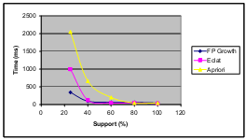
Comparison of Algorithms
Figure 3: Comparison of apriori, éclat and FP Growth algorithm on artificial dataset when the number of attributes are made three times the original.

Slide 36
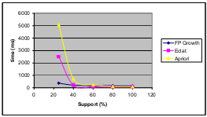
Comparison of Algorithms

Slide 37
Time Complexity
Apriori Algorithm: Scan database at every level of breadth first search. Apriori’s outer loops are bounded by the number of common prefixes.
Worst case: O(N ²)
FP Growth : Best case: O(N log N)
Worst case: O(N ² )
ECLAT : Worst case: O(k(k+1)
[K is the number of items]

Slide 38
CONCLUSION
FP Growth is the best among the three algorithms and is thus most scalable.
Eclat performs poorer than FP Growth and the Apriori performs the worst.

Slide 39
Reference
Charu C. Aggarwal, Jiawei Han, Aggarwal Charu C., Han, Jiawei. An Introduction to Frequent Pattern Mining, Springer International Publishing: Cham 2014.
Agrawal R, Imielinski T, Swami A (1993) Mining association rules between sets of items in large databases. In: Proceedings of the 1993 ACM-SIGMOD international conference on management of data (SIGMOD’93), Washington, DC, pp 207–216.
Agrawal R, Srikant R (1994) Fast algorithms for mining association rules. In: Proceedings of the 1994 international conference on very large data bases (VLDB’94), Santiago, Chile, pp 487–499.
R. Agarwal, C. C. Aggarwal, and V. V. V. Prasad. Depth-first Generation of Long Patterns, ACM KDD Conference, 2000: Also appears as IBM Research Report, RC, 21538, 1999.
E. Cohen. M. Datar, S. Fujiwara, A. Gionis, P. Indyk, R. Motwani, J. Ullman, and C. Yang. Finding Interesting Associations without Support Pruning, IEEE TKDE, 13(1), pp. 64–78, 2001.
R. Agrawal, and R. Srikant. Mining Sequential Patterns, ICDE Conference, 1995.
Jiawei Han , Jian Pei , Yiwen Yin, Mining frequent patterns without candidate generation, Proceedings of the 2000 ACM SIGMOD international conference on Management of data, p.1-12, May 15-18, 2000, Dallas, Texas, USA

Slide 40
Thank You

